Slide 1
Human Resource Management
MBA
Dr. Sumagna Bhowmick

Slide 2
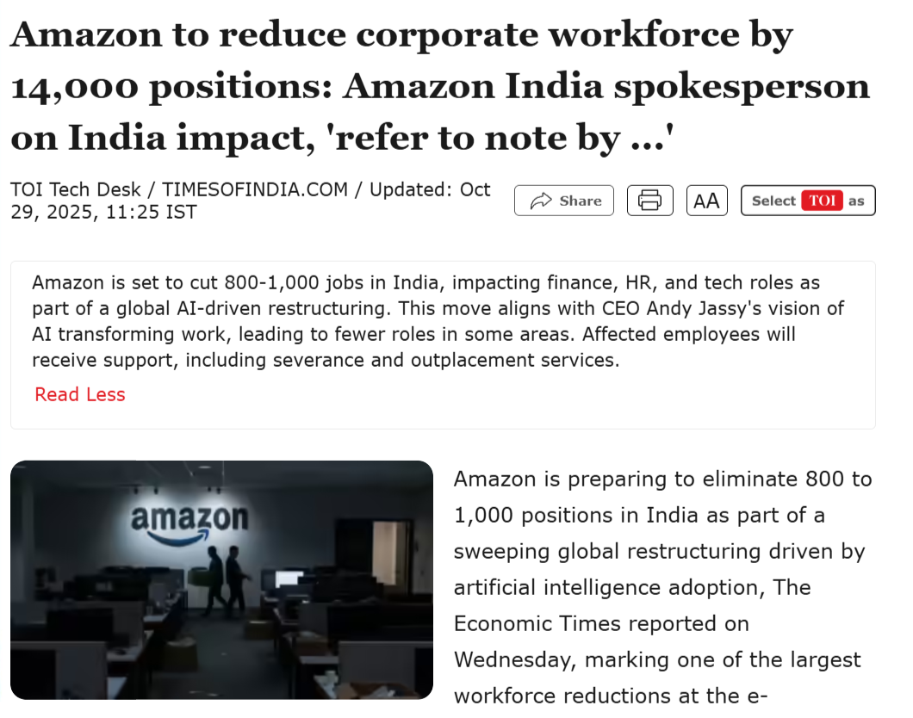
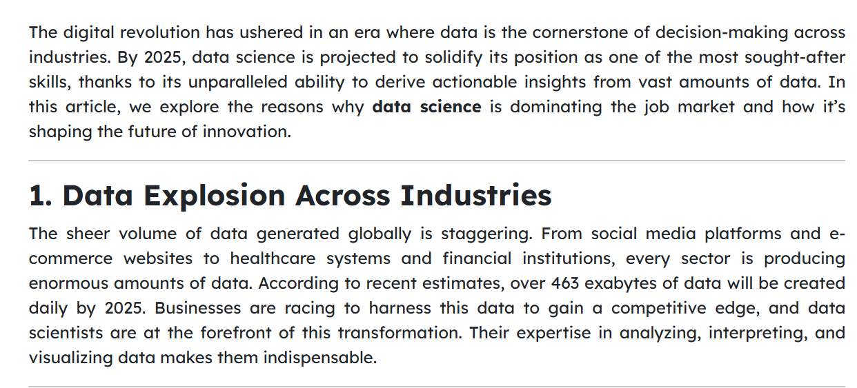
Reflect
If you were the HR Head at Amazon, what would workforce planning involve?
Notes:
What is happening here?
Why is this happening?
So Amazon is not shrinking because business is failing. It is restructuring because technology has changed how work is done - This is reactive workforce planning — responding to technological and strategic change
But if companies are laying off, why is demand increasing?
New types of jobs are emerging
Companies still need people, but with different skills
Not all roles are being automated
So what kind of workers are in demand?
If you were the HR head ---
Forecast future skill needs
Identify roles at risk / becoming redundant
Decide: who to reskill vs. who to redeploy vs. who to exit
Plan recruitment for new critical skills
Design transition & support systems

Slide 3
Reflect
Is workforce planning just about cutting people?

Slide 4
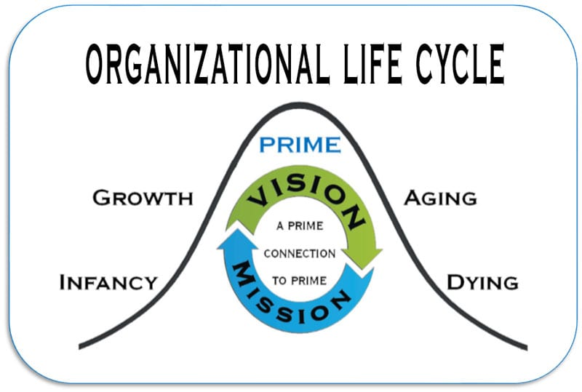
Workforce Planning
Workforce Planning concentrates on assessing the human resources requirements by an organization through the different stages of the organization’s life cycle
Workforce Planning makes sure that right kinds of people in right numbers are available at the right time and in the right places to help implement business strategies
Workforce Planning occurs within the broad context of organizational and strategic business planning.
Notes:
Growth - The quick commerce market — including players like Blinkit, Zepto, and Swiggy Instamart — is booming, attracting heavy investment and rapid expansion of dark stores and logistics networks.
Instamart and the Young India Skills University on Tuesday s ..
Read more at: http://timesofindia.indiatimes.com/articleshow/126397378.cms?utm_source=chatgpt.com&utm_source=contentofinterest&utm_medium=text&utm_campaign=cppst
Rapido in early launched 2015 – 2016 It was an early-stage platform when no major competitor existed (at the time)
Hyperlocal mobility startup
This fits the introduction phase: new business model, uncertain market, tiny workforce planning.
Rapido today surpasses Uber, Ola in the two-wheeler segment.. And in four wheeler – Rapido 30 percent, uber 50, ola 20
OLA – Employee count has dropped 57 percent in April 2024 while Uber, and Rapido workforce continues to expand

Slide 5
Reflect
From all these examples, what is the connection between business strategy and workforce planning?
As a company moves from infancy to growth to aging, what must happen to its workforce?
Notes:
Strategy decides what kind of people are needed
When strategy changes, workforce must change
Growth needs hiring, decline needs restructuring, innovation needs new skills
In infancy → small, flexible teams
In growth → more hiring and specialization
In aging → restructuring, reskilling, or downsizing

Slide 6
Factors affecting workforce planning
External Factor | Description | Implication for Workforce Planning
Economic Factors | Overall economic conditions such as growth, recession, inflation, and employment levels | Determines hiring capacity, wage levels, and need for expansion or downsizing
Technological Factors | Speed of technological change, automation, and digital transformation | Leads to skill obsolescence, demand for new skills, and need for reskilling and upskilling
Legal Factors | Labour laws, judicial decisions, government regulations, and compliance requirements | Sets limits on hiring, termination, contract labour, and working conditions
Demographic Factors | Age structure, education levels, gender composition, and workforce participation rates | Influences availability of talent, succession planning, and training needs
Geographic Factors | Location of operations and availability of local labour markets | Affects recruitment sources, mobility, and workforce distribution
Social Factors | Social values, cultural expectations, diversity norms, and work–life balance preferences | Shapes HR policies related to inclusion, flexibility, and workplace practices
Notes:
Global economic pressures reduce IT spending by overseas clients, making Indian IT firms cautious about recruitment. Instead of expanding headcount, companies focus on controlling costs and reskilling current employees. Thus, workforce planning moves from hiring to capability building.
It might sound dramatic, but according to the World Economic Forum’s Future of Jobs Report 2025, that’s the direction we’re headed. The report warns that 39% of core job skills will become outdated by 2030 because of the rapid evolution of technology, automation and changing business needs. Skills like critical thinking, creativity, emotional intelligence, and digital fluency are becoming the new currency of employment. On the flip side, repetitive, rules-based roles that once powered entire industries are losing their relevance. https://etedge-insights.com/technology/artificial-intelligence/careers-that-wont-survive-the-next-5-years-39-of-job-skills-will-be-obsolete-by-2030/
The Constitution of India and rules require reservation (affirmative action) for Scheduled Castes (SC) and Scheduled Tribes (ST) in public sector employment
Under the Rights of Persons with Disabilities Act, 2016, organisations with 20 or more employees must reserve at least 4% of jobs for persons with benchmark disabilities, including:
Visual impairment
Hearing impairment
Locomotor disability
Intellectual disability
Under the Occupational Safety, Health and Working Conditions (OSH) Code, 2020, The new OSH Code generally prohibits engagement of contract labour in core activities. This means that contract workers should not be used for permanent, essential business functions unless one of the specified exceptions applies (e.g., the nature of work is ordinarily done through contractors, intermittent task, or a sudden spike in workload requiring temporary help
4. Demograohic aging vs young
5. Geographic factors – cheap labor in India..

Slide 7
Factors affecting workforce planning
Internal Factor | Description | Implication for Workforce Planning
Business Strategy | Workforce planning must align with the organization’s evolving business strategies such as expansion, diversification, mergers, acquisitions, or globalization. | Changes in strategy require changes in workforce size, skill mix, structure, and deployment of employees.
Strategic Orientation (Miles & Snow Typology) | Organizations can be classified as Defenders, Prospectors, Analyzers, or Reactors, based on how they respond to market changes. | Different strategies require different workforce profiles (e.g., innovation-focused vs efficiency-focused), affecting skill forecasting and staffing models.
Time Horizon | The length of planning period (short-term vs long-term) adopted by the organization. | Long-term planning focuses on leadership development and succession; short-term planning focuses on immediate staffing needs.
Organizational Growth Cycle | Stage of organizational life cycle such as start-up, growth, maturity, or decline. | Workforce needs shift from flexible generalists to specialized roles, then to optimization and restructuring.
Quality of Information Systems | Availability and accuracy of workforce data related to skills, performance, turnover, and productivity. | Better data enables accurate forecasting, skill-gap analysis, and informed workforce decisions.
Notes:
DefenderEfficiency, cost control, stable productsLimited product variety, predictable markets, process optimizationIndian Railways (core services), FMCG staple producers, Cement & steel manufacturers, Utility companies (power, water) ProspectorInnovation, new markets, experimentationHigh R&D, frequent product launches, risk-takingStartups, EV startups, Fintech startups, New-age AI companies AnalyzerStable core + selective innovationMaintain efficiency in core business while innovating at edgesApple, Crocs, Large IT firms (legacy services + digital), Large banks with digital arms ReactorNo clear long-term strategyRespond late to market changes, inconsistent decisionsNokia (late smartphone response), Kodak (late digital shift), Traditional retail chains facing e-commerce

Slide 8
Reflect
How can an organization achieve its future business goals if it plans its workforce only for today’s needs?

Slide 9
Strategic Workforce Planning
Strategic planning is about understanding where the business is heading in the next few years and identifying the capabilities, roles, and leadership needed to succeed in that future.
It involves:
Looking at the future business environment (markets, technology, competition)
Identifying critical positions that will drive business success
Understanding what skills, leadership, and capabilities will be required
Taking an external labour market view, what talent will be available or scarce in the future
Designing a future organizational structure, not just filling current roles
https://economictimes.indiatimes.com/jobs/how-philips-is-using-a-breakthrough-idea-to-show-employees-the-big-picture/articleshow/14843930.cms?from=mdr
Notes:
https://hr.economictimes.indiatimes.com/news/industry/strategic-workforce-planning-reshape-your-talent-acquisition-with-analytics/119854249
How LinkedIn Talent Insights Helps in Strategic Workforce Planning
When we say “looking at future business environment (markets, technology, competition)”, platforms like LinkedIn help by showing:
Emerging skills in the market (e.g., AI, data engineering, cybersecurity)
Which companies are hiring for which skills (competitive intelligence)
Where talent is located geographically
How fast certain roles are growing or declining
Talent supply vs demand trends

Slide 10
Difference between workforce planning and strategic workforce planning
Basis | Workforce Planning | Strategic Workforce Planning (SWP)
Focus | Filling current and short-term manpower needs | Preparing workforce for long-term business goals
Time Horizon | Short-term (usually 1 year) | Long-term (3–5 years or more)
Driver | Current vacancies and operational needs | Business strategy, market and technology trends
Key Question | How many people do we need now? | What capabilities and leadership will we need in the future?
Scope | Headcount and basic skills | Skills, leadership, critical roles, and capabilities
Approach | Reactive | Proactive and predictive
Ownership | Mainly HR function | Shared by HR and business leaders (line managers)
Tools Used | Manpower budgets, attrition data | Scenario planning, talent analytics, labour-market insights
Outcome | Positions are filled | Organization is future-ready

Slide 11
Strategic Workforce Planning
Step | Stage | What Is Done at This Stage | Purpose for Workforce Planning
1 | Strategic Planning | Understand business goals, industry challenges, growth plans, and external pressures; review existing workforce data systems | Ensures workforce planning is aligned with business strategy and future direction
2 | Workforce Analysis | Assess current workforce size, skills, experience, productivity, and critical roles | Creates a clear picture of existing human capital and current capabilities
3 | Future Requirement Analysis | Forecast future workforce needs in terms of skills, roles, numbers, and locations based on business roadmap | Identifies what kind of workforce will be needed to execute future strategy
4 | Gap Analysis | Compare current workforce with future requirements to identify skill gaps, performance gaps, and manpower gaps | Highlights areas where hiring, reskilling, redeployment, or restructuring is needed
5 | Workforce Action Planning | Design interventions such as recruitment plans, training programs, succession planning, redeployment, or outsourcing | Converts analysis into concrete HR and talent management actions
6 | Execute and Evaluate | Implement workforce plans, track outcomes, review metrics, and revise plans as business conditions change | Ensures continuous alignment between workforce and business needs

Slide 12
Benefits of Strategic Workforce Planning
Area | Benefit | Explanation
Strategy Execution | Alignment with business goals | Workforce capabilities are planned to directly support long-term business strategy.
Skill Readiness | Future-oriented skill development | Anticipates emerging skills and prepares employees through reskilling and upskilling.
Talent Stability | Reduced reactive hiring and layoffs | Prevents crisis-driven recruitment or downsizing by forecasting needs in advance.
Leadership Continuity | Strong succession pipeline | Identifies and develops future leaders for critical positions.
Cost Management | Optimized talent investment | Helps choose between hiring, training, redeployment, or outsourcing.
Organizational Agility | Faster response to change | Enables quick adjustment to market, technology, and competitive shifts.
Competitive Advantage | Sustainable performance | Builds unique workforce capabilities that support long-term growth.

Slide 13
Methods of Forecasting Personnel (Labour) Demand
Method | What It Is | How It Works | When It Is Useful
Trend Analysis | Uses past employment data to predict future needs | Studies historical patterns of workforce growth and projects them forward | Stable organizations with predictable growth patterns
Ratio Analysis | Uses ratios between business activity and number of employees | Calculates manpower based on output, sales, or workload ratios (e.g., sales per employee) | When clear relationship exists between workload and staffing
Managerial Judgment | Forecast based on managers’ experience and knowledge | Managers estimate future manpower needs based on plans and expectations | When quantitative data is limited or during major changes
Scatter Plot | Uses graphical relationship between business volume and staff size | Plots business levels against workforce size to find correlation | When manpower varies with production or service volume
Workload Analysis | Estimates staff based on task time and volume of work | Calculates total work hours required and divides by standard hours per employee | Operational planning and staffing for service or production units

Slide 14
Methods of Forecasting the Supply
Supply Source | Method / Tool | What It Measures | Purpose in Workforce Planning
Internal Supply | Personnel Replacement Charts | Identifies who can replace whom for key positions | Helps plan promotions and internal mobility
 | Markov Analysis (Transition Matrices) | Tracks employee movement between jobs, promotions, exits | Predicts future internal workforce distribution
 | Skills Inventories | Database of employees’ skills, qualifications, experience | Matches existing skills with future role requirements
 | Talent Pools | Groups employees with high potential or scarce skills | Supports leadership and critical role pipelines
External Supply | Labour Market Analysis | Availability of skills in external job market | Helps decide feasibility of external hiring
 | Educational Pipeline Data | Number of graduates in relevant fields | Predicts future entry-level talent availability
 | Industry Hiring Trends | Competitor hiring patterns and skill demand | Indicates market competition for talent
 | Talent Analytics Platforms (e.g., labour market dashboards) | Skill demand, migration, and location trends | Supports location and hiring strategy decisions
Predictive Monitoring | Turnover & Attrition Analysis | Likely exits by role, level, or location | Adjusts supply forecasts dynamically
 | Retirement Forecasting | Expected retirements based on age profiles | Anticipates experience and leadership gaps
 | Performance & Potential Tracking | Readiness of employees for future roles | Guides development and succession pipelines
Integration Stage | Matching Supply with Demand | Comparison of projected workforce supply and future needs | Forms basis for hiring, training, redeployment, or succession planning
Notes:
Demand forecasting → How many people and skills we need
Supply forecasting → How many people and skills we will have
Gap between them → Leads to hiring, training, redeployment, or succession planning

Slide 15
Reflect
Now that we know how many people we will need and where they will come from, what should the organization actually Do?

Slide 16
Matching Supply and Demand – Workforce Action Plan
Promote (Succession Planning) Filling critical and leadership roles through internal talent pipelines and readiness planning
Train / Reskill Developing existing employees to meet future skill requirements
Hire Recruiting from the external labor market when internal supply is insufficient
Redeploy Transferring employees across roles, departments, or locations
Outsource / Automate Using vendors or technology for non-core or efficiency-driven activities
Downsize / Hiring Freeze (if surplus exists) Managing excess workforce through attrition, restructuring, or cost controls

Slide 17
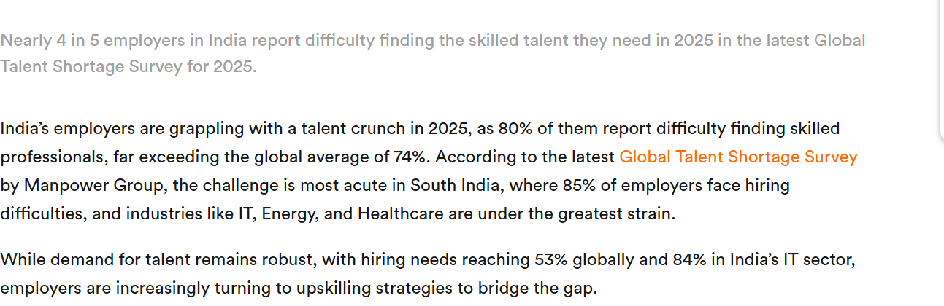
Discussion
As a HR professional how are you going to address the issue?

Slide 18
